Slide 1

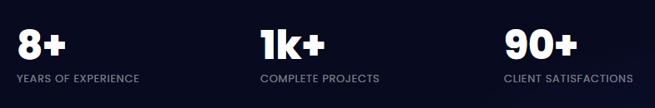
Photo
ZIKRY ADJIE NUGRAHA
AI ENGINEER | DATA SCIENTIST
Download My CV
Github Repo
LinkedIn

Slide 2

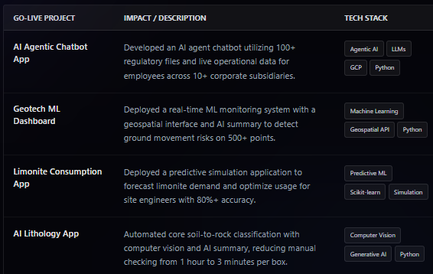
WORK EXPERIENCE
December 2025 - Present
Spearheaded end-to-end AI application development, focusing on backend architecture (APIs, databases, AI ML models), frontend UIs, and cloud deployment.
Designed AI and ML algorithms to analyze geology and mining-related data to support data-driven decision-making and improve overall operational strategies.

Slide 3
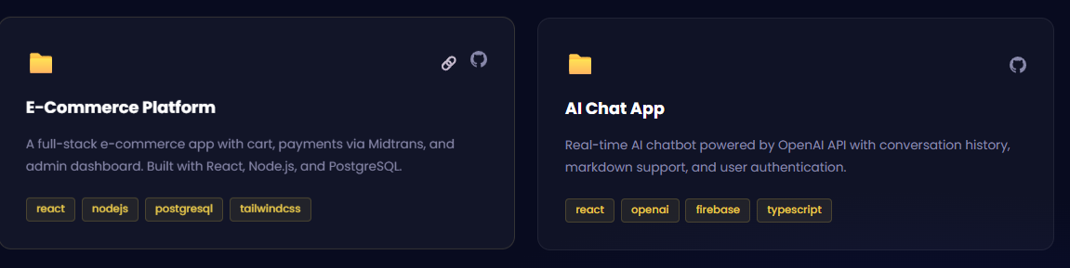
PERSONAL PROJECTS
December 2025 - Present

Slide 4
PERSONAL PROJECTS
Languages & Web
Python, SQL, JavaScript, HTML, CSS, FastAPI, Flask, Streamlit, Bootstrap, ReactJS, BeautifulSoup, Selenium
Cloud & Infrastructure
AWS (Lambda, EC2, ECR, AppRunner, Sagemaker), GCP (Cloud run, Artifact Registry), Microsoft Azure (ML Studio), Docker Compose, Traefik, CI/CD, Granian, Gunicorn, AWS & GCP Secret Manager
Advanced AI & Agentic Platform
Azure OpenAI, Google Gemini, Vertex AI, Anthropic Claude, Hugging Face, Langchain, LangGraph, RAG chains, Multi-agentic AI pipelines, Prompt Engineering, AI Infrastructure
December 2025 - Present
ML, Computer Vision & NLP
Scikit-learn, XGBoost, Random Forest, ARIMA, BQML, GCP VisionAI, YOLO, Scikit-image, GPT-4 Vision, Tensorflow, Keras, OCR, Pillow, Topic Modelling, Jaro-Winkler, Cosine Similarity, Fuzzy matching, Regex
Database & Storage
Amazon RDS, Amazon S3, Google BigQuery, Google Cloud Storage, PostgreSQL, SQL Server, SQLAlchemy, MySQL, Azure Cosmos DB, Qdrant, SFTP
Data Analytics & Visualization
GA4, Google Ads Data Hub, Google Ads Manager, Google Looker Studio, Tableau, PowerBI, Plotly Dash, Matplotlib, Seaborn,

Slide 5
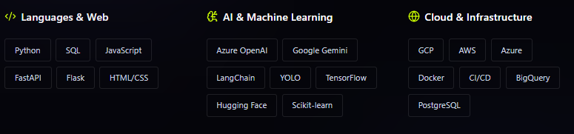
TECH STACK ARSENALS
December 2025 - Present

Slide 6
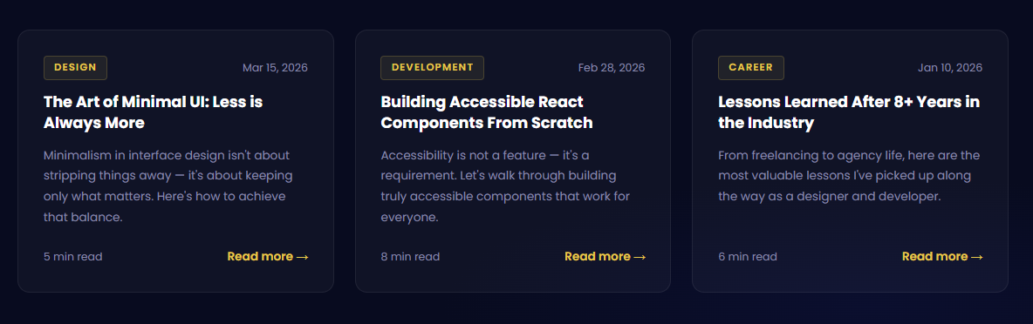
RESEARCH ARTICLE AND PUBLICATIONS
December 2025 - Present
Note: Can be swipe to the right and left
Ensure every article is link and has a picture in it above the title

Slide 7
TEACHING AND SEMINAR EXPERIENCE
December 2025 - Present
Note: Can be swipe to the right and left
Ensure every article is link and has a picture in it above the title

Slide 8
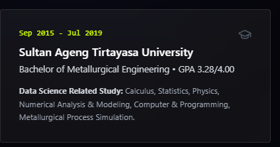
EDUCATION
December 2025 - Present

Slide 9
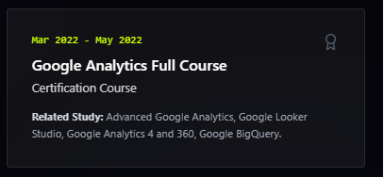
TRAINING AND CERTIFICATIONS
December 2025 - Present

Slide 10
ACHIEVEMENTS AND AWARDS
December 2025 - Present
Note: Can be swipe to the right and left
Ensure every achievement is link and has a picture in it above the title

Slide 11
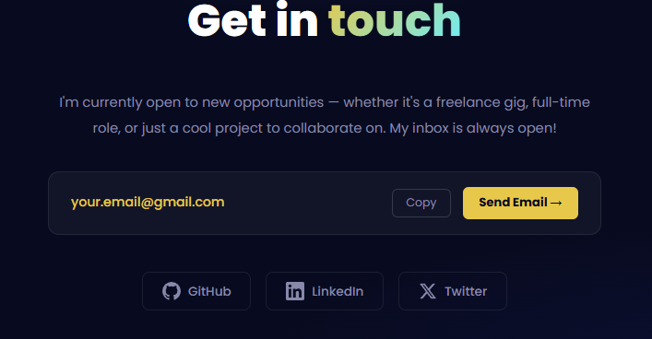
GET IN TOUCH
December 2025 - Present
Whatsapp number > copy > send Whatsapp message

Slide 12
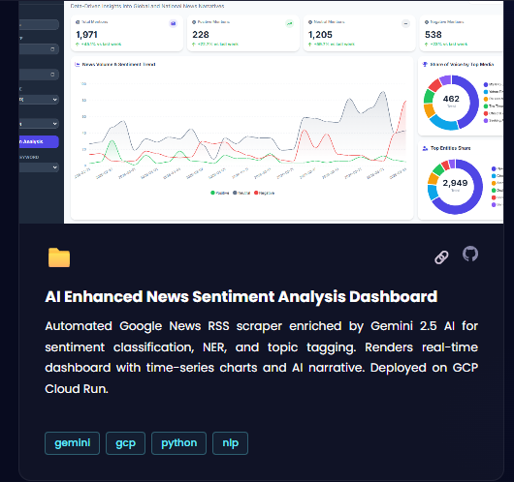
Demo
Github

